Slide 2

Cloud Adoption Framework
Overview
Part 4 – Drive agility in your business with Azure

Slide 3
Agenda
Introduction to DevOps
The Microsoft Story
Azure DevOps and GitHub

Slide 4
Microsoft Cloud Adoption Framework
Business
Platform
Workload
Define strategy
Understand motivations
Business outcomes
Business justification
Prioritize project
Adopt
Ready
Azure readiness guide
First landing zone
Expand the blueprint
Best practice Validation
Migrate
• First workload migration
• Expanded scenarios
• Best practice validation
• Process improvements
Manage
Business commitments
operations baseline • Ops maturity
Innovate
• Innovation guide
• Expanded scenarios
• Best practice validation
• Process improvements
Plan
Digital estate
Initial organization alignment
Skills readiness plan
Cloud adoption plan
Govern
Methodology • Benchmark
initial best practice • Governance maturity
Well-Architected
Operational Excellence | Performance Efficiency | Reliability | Security | Cost Optimization
Notes:
This slide is intended to set the direction for CAF and showing the intersect with Well-Architected.
The next slide is an example of how we talk to Governance..

Slide 5
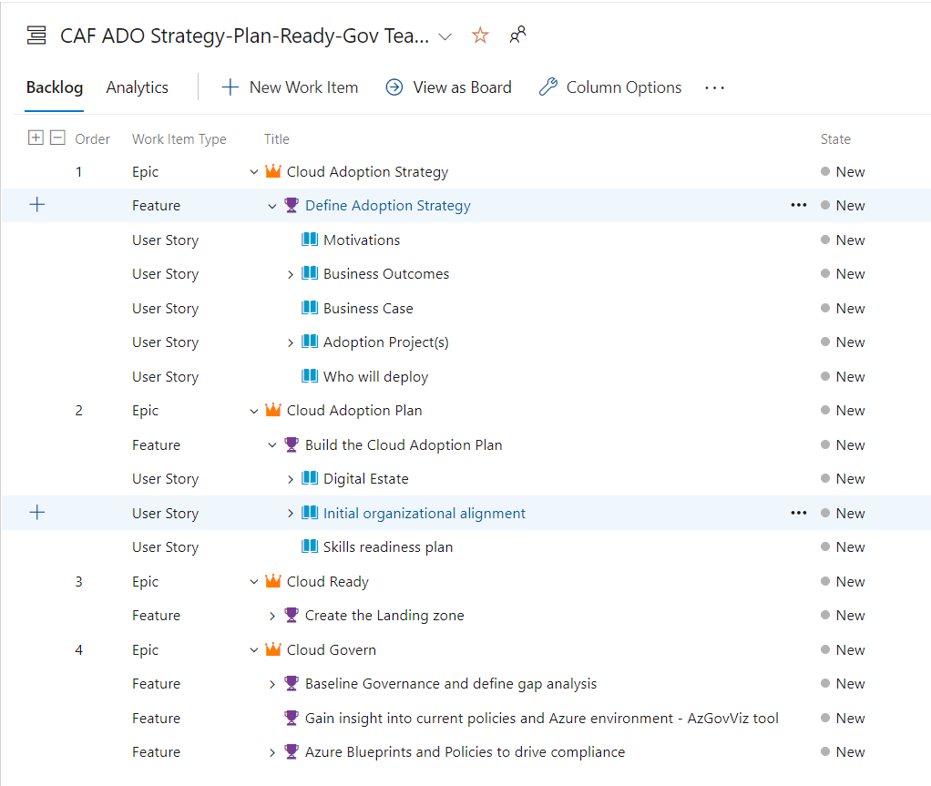


What is DevOps?
Build & Test
Deploy
DevOps is the union of people, process, and products to enable continuous delivery of value to your end users.
Develop
Operate
Continuous Delivery
Plan & Track
Monitor & Learn
Azure DevOps
GitHub

Slide 6

Dave’s 8 track

Slide 7
The Azure DevOps Journey
105K employees engaged
85K deployments/day
Sprint 179
December 2020
VSTS Preview
1ES
Windows on Git
Azure Pipelines
Sprint 140
Sep 2018
Sprint 1
August 2010
Sprint 29
June 2012
Sprint 67
June 2014
Sprint 102
May 2017
2010
2011
2012
2013
2014
2015
2016
2017
2018
2019
2020
400 Open Source Projects
Microsoft on GitHub
VS Code
Semmle
GitHub Acquired
March 2010
July 2014
April 2015
Join Linux Foundation
Nov 2016
Oct 2018
GitHub Actions
Security
Nov 2019
8.8k open source projects 27k employees contributing
Notes:
Go to the Features Timeline and compare the number of features released in Nov. 2014 (6) release to the Nov. 2019 release (23):
https://docs.microsoft.com/en-us/azure/devops/release-notes/2014/nov-04-team-services
https://docs.microsoft.com/en-us/azure/devops/release-notes/2019/sprint-160-update

Slide 8



Here’s how Microsoft builds apps of the future
Adopting a growth mindset
Creating a culture of customer obsession
Aligning to shared objectives

Slide 9
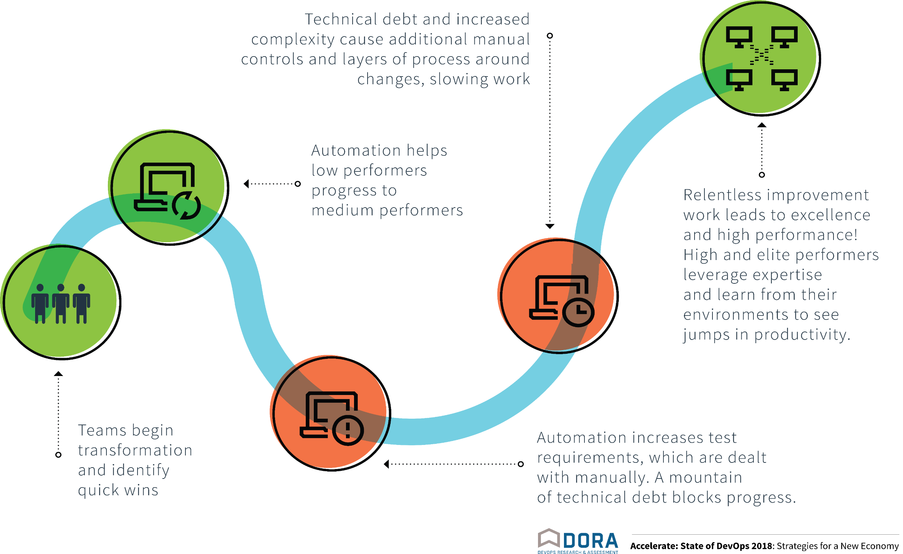
Progress follows a J-curve
Getting clean is highly manual
Staying clean requires dependable automation
Notes:
Dave’s version of Sam’s slide with additional animations.

Slide 10
Show n’ Tell
Azure DevOps Patterns
Adoption Framework content – OKRs and Operating Model
Microsoft Learn DevOps
Building Release Pipeline for AppService
GitHub Actions Getting Started
PartsUnlimited example

Slide 11
References
http://aka.ms/adopt
http://aka.ms/adopt/plan/generator
http://docs.Microsoft.com/learn - DevOps learning path, GitHub + Azure DevOps
github/roadmap: GitHub public roadmap – GitHub Roadmap
https://github.blog/2021-01-21-changelog-2020-edition/#working-better-with-automation

